Slide 1
AGREECU TURE
Abdullah Alghamdi, Irene Kim, Jewon Moon
English School of Canada (UCTP)
Instructor : Edward Newton

Slide 2
Outline
Executive Summary
Company Summary
Products and Services
Market Analysis
Operational Plan
Financial Plan

Slide 3
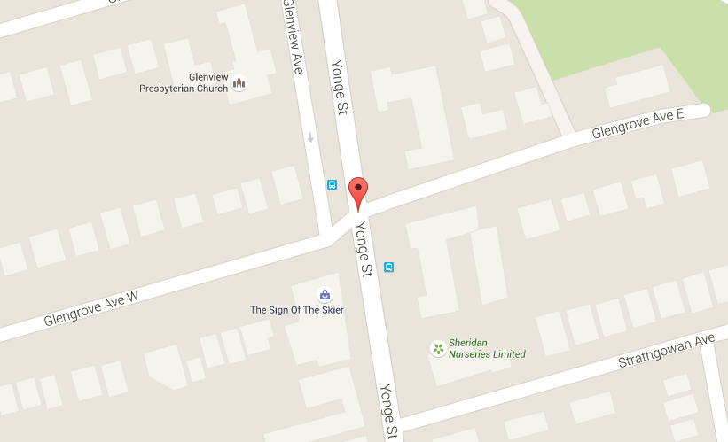
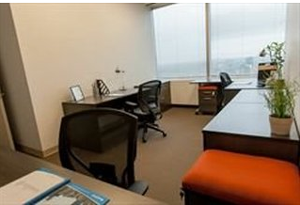
Operational Plan
Location
- located on the Yonge St
- $700 per month + $5 per person

Slide 4


Operational Plan
Permits and Licensing
- Canadian Organic Standards (COS)
- Ontario Driver License
- Master Business License

Slide 5

Operational Plan
Risk management
- decreasing volume of orders in winter.
- selling organic eggs, milk, and meat in winter.
Supply chain
- co-operation with United Parcel Service.
- contract with certificated organic farms.

Slide 6
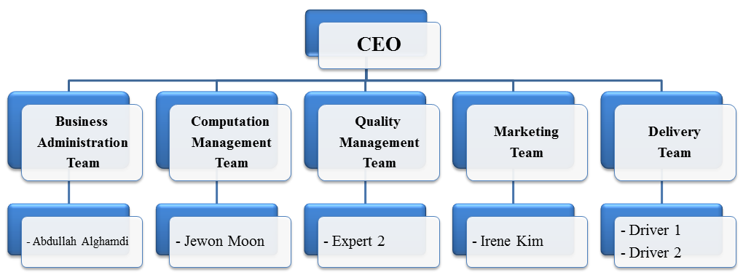
Operational Plan
Personnel
- 5 parts of team
- 4 experts and 2 drivers

Slide 7
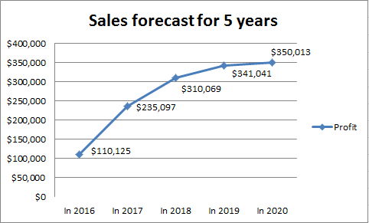
Financial Plan
Sales forecast
- increase number of farms every year.
- volume of orders also increase.

Slide 8
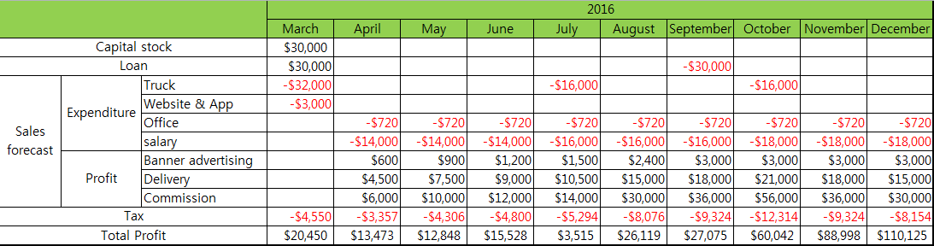
Financial Plan
Cash flow statement
- starting with little capital stock.
- pay back a loan to bank after 5 month.

Slide 9
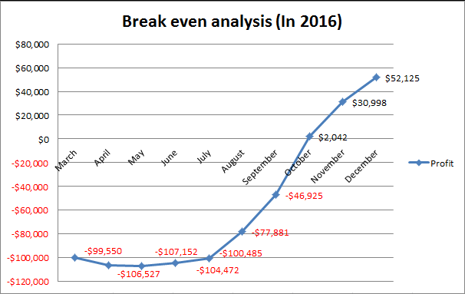
Financial Plan
Break even analysis
- reach the break-even point after 7 months

